Slide 1



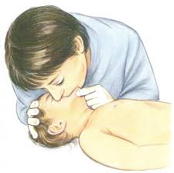

BY
Dr. Ashraf Mohamed El-Saghier
M.D. pediatrics
Basic Life Support

Slide 2
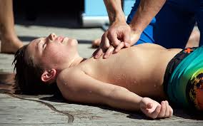
Basic Life Support
Cardiopulmonary arrest is the final common pathway for many life-threatening diseases.

Slide 3

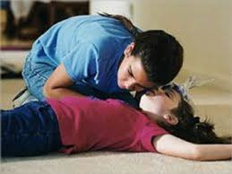
Basic Life Support
Steps of basic life support:
I) Determine responsiveness:
By gentle shaking, tapping or shouting at the patient. If no response but the patient is breathing, call for assistance.

Slide 4
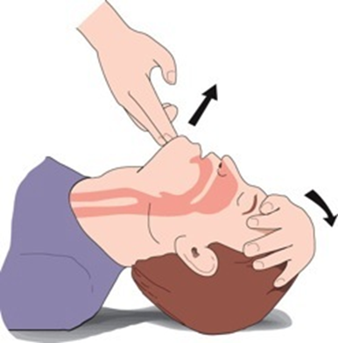
Basic Life Support
II) Airway opening:
This is usually done by
A) Head tilt-chin lift maneuver: by using one hand to tilt the head and extending the neck while the index finger of the other hand lifts the mandible outward by lifting on the chin. This maneuver is contraindicated if neck injury is suspected.

Slide 5
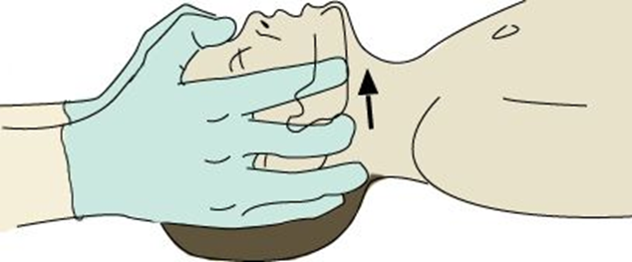
Basic Life Support
B) Jaw thrust maneuver: if neck injury is suspected, the airway opened by jaw thrust while the cervical spine is completely

Slide 6

Basic Life Support
III) Breathing establishment:
After the airway is opened, the rescuer must determine if the child is breathing. The rescuer looks for rise and fall of the chest and abdomen, listens for exhaled air, and feels for exhaled airflow at the mouth.

Slide 7
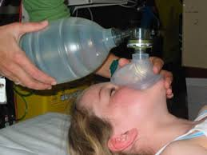
Basic Life Support
III) Breathing establishment:
If there is chest rise and exhaled air is felt, the patient is ventilated.
If there is chest rise and exhaled air is not felt, the patient is not ventilated and rescue breathing is maintained by one of 3 methods:
Mouth to mouth
Mouth to mask ventilation
Bag mask ventilation

Slide 8

Basic Life Support
III) Breathing establishment:
If the child received the correct volume of air with each breath, chest rise will occur.
If chest rise does not occur, either the airway is obstructed or more breath volume is needed, reposition of the head and try ventilation again.
If unsuccessful, there is airway obstruction.

Slide 9
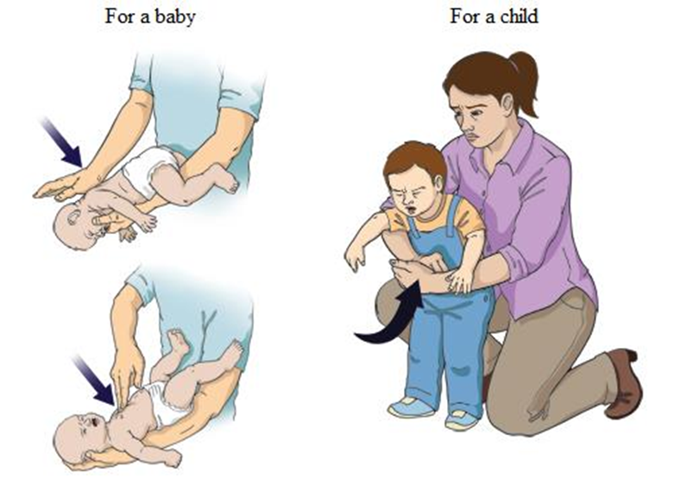
Basic Life Support
III) Breathing establishment:
Methods of relieving airway obstruction:
In infants: by backblows 4 times and chest thrusts 4 times.
In older child: by manual abdominal thrusts for 6 times.

Slide 10
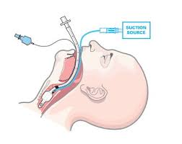
Basic Life Support
III) Breathing establishment:
If after these procedures ventilation is not restored, endotracheal intubation is indicated.
For proper intubation oropharyngeal suctioning, nasogastric suctioning and preoxygenation for 3-4 minutes must be done.
Proper intubation is suggested by equal breath sounds and symmetrical chest movements. Monitoring for intubation is done by pulse oximetry for O2 saturation.

Slide 11
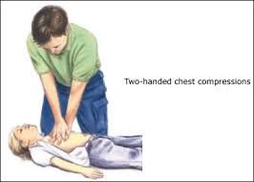
Basic Life Support
IV) Circulation support:
Assess brachial or femoral pulse: if absent, start chest compression.
Chest compressions must always be accompanied by ventilation.

Slide 12
Basic Life Support
Technique of chest compression:
 | Method | Hand position | Sternal depression | No./min
Infant | Encircle the chest or use 2 fingers | One finger width below the intramammary line | 0.5 – 1 inch | 100
Toddler | One hand | Lower 1/3 of the sternum | 1 – 1.5 inch | 80 - 100
Child | Two hands | Lower 1/3 of the sternum | 1.5 – 2 inches | 80 - 100

Slide 13
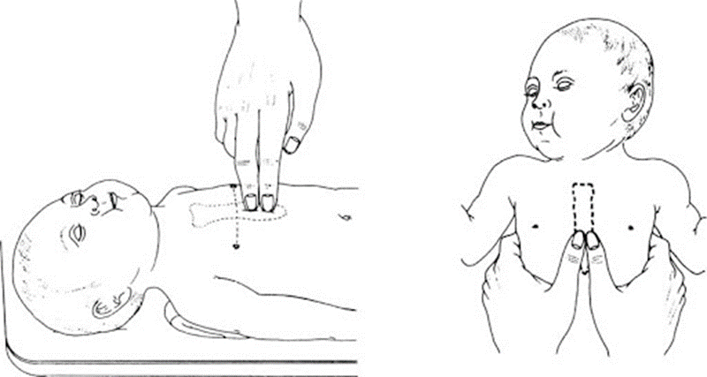
Basic Life Support
IV) Circulation support:
Technique of chest compression in infants

Slide 14

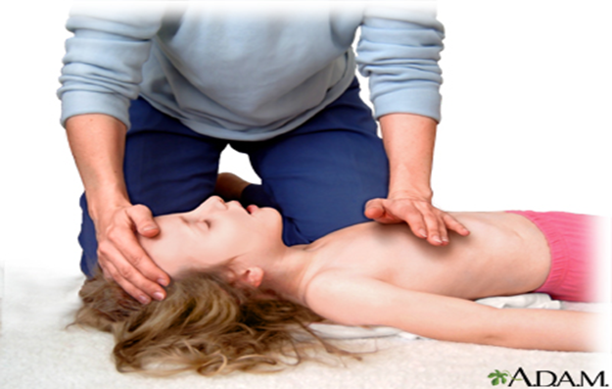
Basic Life Support
IV) Circulation support:
Technique of chest compression in a child

Slide 15
Basic Life Support
IV) Circulation support:
3. Venous access for administration of fluids and medications:
Children < 5 years old: the preferred venous access site is the largest most accessible veins e.g. femoral vein, median cubital vein or the saphenous vein. If this failed after 90 seconds, try the intraosseous line at the proximal end of the tibia, if this failed try the saphenous vein cut down or the central line.
Children > 5 years: try to get peripheral line if failed after 90 seconds, try a central line or cut down.

Slide 16
Basic Life Support
IV) Circulation support:
4.Oxygen is given immediately.
5.Medications;
a. Epinephrine (adrenaline) for cardiac arrest.
b. Dopamine for shock
c. Atropine to increase heart rate in case of bradycardia.
d. Sodium bicarbonate in case of metabolic acidosis and hyperkalemia.

Slide 17


